Slide 1
Building Up Nurses
May 16, 2021
Track 4.07
Presented by:
Jennifer Brant MHI, BSN, UZIT, CRRN
Faith Bontrager MHI, BSN, RN
Sadao Nakachi, MBV, BSN, RN, CEN
Notes:
Thank you for joining us.
Today we will be talking with you about the need for self care in Nursing, and innovative way to support your nursing

Slide 2

Track 4.07
“
I don’t have time to take care of myself – everyone else needs me.
”
The costs and benefits of nurse turnover: a business case for nurse retention.(includes abstract) Jones CB; Gates M; Online Journal of Issues in Nursing, 2007; 12(3): 7p-7p. (1p) (Journal Article - tables/charts) ISSN: 1091-3734 AN: 105914000
Notes:
Meet Mary a second year Nurse on a Med/Surg unit that was repurposed for Covid patients. She was encouraged to practice self care; she told us she is trying. She took a 5 min nature walk but when she returned, she overheard her coworkers griping to each other about her ignoring her patient. She feels overwhelmed, frustrated, and alone and wonders, “Why did I ever go into nursing? She often cries in her car on the way home.
This morning Mary was standing by the “We care about our nurses” poster, having just run out of masks, frustrated because she hadn’t been able to administer pains med (3calls) , her charge nurse notified her that she was getting an extra patient and that discharge orders were written for her patient in 603 and the family wanted to be home before rush hour.
But it’s not JUST Mary..

Slide 3

“Running on empty”(CNN)
Track 4.07
30% of nurses quitting cite burnout
35% of nurses stated that their work had meaning
25% of nurses are optimistic about the future
10 million nurses to leave workforce by 2030
https://www.cnn.com/2021/02/25/us/nurses-quit-hospitals-covid-pandemic-trnd/index.html
Arndt, Rachel Z.; Modern Healthcare, 10/23/2017; 47(43): 0036-0036. (1p) (Article) ISSN: 0160-7480 AN: 125903046
https://dailynurse.com/icn-warns-covid-effect-could-drive-millions-of-nurses-to-leave-profession/
Notes:
Unfortunately, Mary is not alone. America’s nurses are literally “running on empty”
•30% of the nurses who quit last year cited burnout
•In a December 2020 survey only 35% of nurses said they felt that their work had meaning
•Only one quarter were optimistic about their future.
Nursing numbers are dwindling to the point that it may impact access to care.

Slide 4


Track 4.07
What if we could create a nursing culture that cares for nurses like we care for patients?
Notes:
Imagine with me for a moment [**PAUSE**].. What if we could create a nursing culture that cares for nurses like we care for our patients.

Slide 5


Our Services
Track 4.07
A culture of health uniquely designed for nurses
Site Assessment & Planning
Training
Administrators
Managers
Nurses
Notes:
We offer a Culture of Health program uniquely designed for Nurses
with a
Site visit
Training for your administrators, management and staff

Slide 6


Our Solution vs. The Competition
Track 4.07
Benefits | Our Solution | Calm | Headspace | Major Organization | Competitor 4
On-Site Consultant
Management Training
Virtual Training
Nursing Resiliency Training
Wellness Podcasts
Notes:
AS you can, compared to the competition, see we’re only the program that arrives at your medical center and addresses culture.

Slide 7




Burnout Financial Impact
Financial Impact
Track 4.07
$22K - $64K
Arndt, Rachel Z.; Modern Healthcare, 10/23/2017; 47(43): 0036-0036. (1p) (Article) ISSN: 0160-7480 AN: 125903046
$2.2M - $6.4M
Notes:
Not only does our solution meet the needs of your nurses, it makes strong business sense.
•If you have 1,000 nurses, and a modest turnover rate of only 10% annually – research indicates it would cost you between 2.2 and 6.4 million dollars to replace that lost staff
•National turnover is documented at 30% of staff annually.

Slide 8


Building Up Nurses Program
Track 4.07
Adding value to your team
• Reduced Employee Turnover
• Improved Patient Satisfaction
• Access to Care
Notes:
This program will add value to your organization by:
•Reducing Employee Turnover •Patient satisfaction - a stable workforce
•Access to care – As your workforce becomes more stable, your institution has adaptability to meet community needs

Slide 9
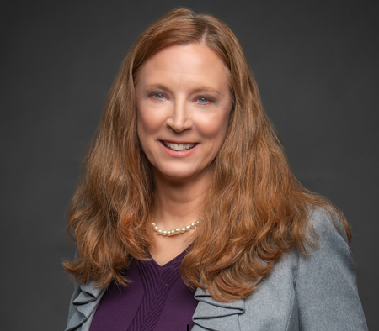
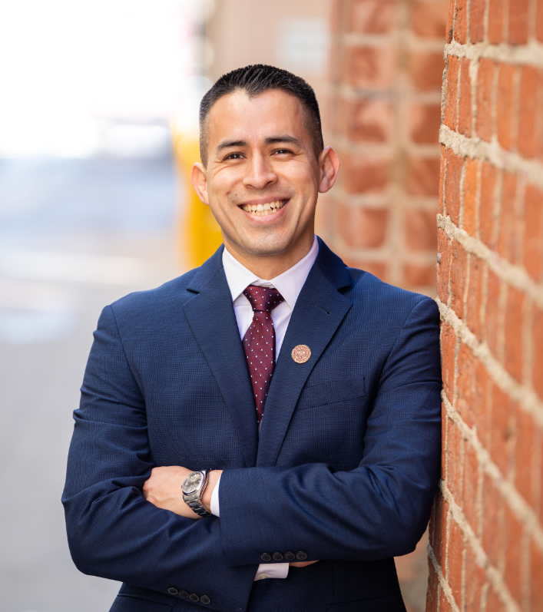
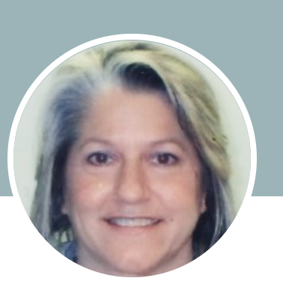
M E E T O U R T E A M
Track 4.07
Faith Bontrager MHI, BSN, RN
Sadao Nakachi, MBV, BSN, RN, CEN
Jennifer Brant MHI, BSN, UZIT, CRRN
Notes:
Our team bring a wealth of experience to the program.

Slide 10

Building Up Nurses
Track 4.07
“Creating a nursing culture that cares for nurses like nurses care for their patients.”
Notes:
Let’s create a nursing culture that cares for our nurses like nurses care for our patients.

Slide 11
Thank You

